Slide 1
UNIVERSITY OF GHANA COLLEGE OF BASIC AND APPLIED SCINCES SCHOOL OF ENGINEERING SCIENCES DEPARTMENT OF COMPUTER ENGINEERING SMART CITY USING LORAWAN
BAMIEBO OBED NUMBO (10847868)
ANNAN MOSES (10845700)
SUPERVISOR: DR. MARGARET RICHARDSON
DATE: 9TH FEBRUARY 2023

Slide 2
Outline
Introduction
Problem Statement
Objectives
Relevance Of Work
Literature Review
Methodology
Project Timeline
Individual Responsibilities
Expected Outcomes
References

Slide 3
Introduction
Smart city leverages on connected technological devices to optimize city functions.
Smart city works alongside internet of things (IoT).
LoRaWAN, the smart choice network for IoT devices

Slide 4
Problem Statement
Nine out of ten people from cities around the world breathe unclean air, which result in respiratory diseases, causing premature deaths.
Cities face challenges with transportation system, including heavy traffic congestion and long commute times.

Slide 5
Problem Statement (Cont’d)
Streetlighting cost 15 – 40% of the overall energy consumed in standard cities worldwide.
Water leakages lead to water contamination and wastage.

Slide 6
Objectives
Collect different environmental data.
Transmit collected data to network server.
Analyse the collected data.
Make collected data accessible to clients.

Slide 7
Relevance Of Work
Improve public health.
Reduce traffic congestion and long commute times in cities to increase productivity.
Control street lighting to cut down energy usage and cost.

Slide 8
Relevance Of Work (Cont’d)
Monitor water wastage.
Assist individuals make Smarter Decisions.

Slide 9
Literature Review
AUTHOR | TITLE | PROJECT | LIMITATIONS
Ashish Jha, Menuka Maharjan | A Smart Lighting System Using The Lorawan Technology | They proposed a system that provides conservation of energy and with efficient monitoring of light. | This technology is only compatible with streetlights.
Priyanka Chaudhari, Aman Kumar Tiwari, Shardul Pattewar, S. N. Shelke. | A Smart Infrastructure Monitoring Using Lorawan | This is an online monitoring system for manhole covers in smart city environment. | This system is only limited to sewage or waste management infrastructure.
João Jaime, Ivo Sousa, Maria Paula Queluz, António Rodrigues. | Planning A Smart City Sensor Network Based On Lorawan Technology | This proposed system collects data in order to manage assests and resources effectively. | Lack of an application server to make collected data or resources available to clients.

Slide 10
Proposed Solution
Collect environmental data using sensors.
Transmit data to network servers using gateways.
Use LoRaWAN to transmit data securely.

Slide 11
Proposed Solution Cont’d
Application server provides functionality to end users.

Slide 12
Methodology
The system will comprise of four (4) main subsystems.
The sensor system: Multiple Lora sensor devices are programmed and configured and placed at points of interest to pick and read data.
The packet forwarder system: Gateways are configured to forward sensor data to a particular network server.

Slide 13
Methodology (Cont’d)
The server system: LoRaWAN is used to transmit data securely to network server and application server.
The application system: Provide dashboard and functionalities to end users.

Slide 14
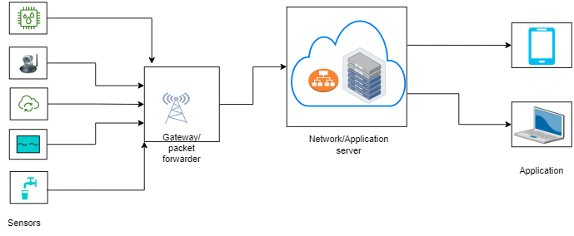
Architectural Diagram

Slide 15
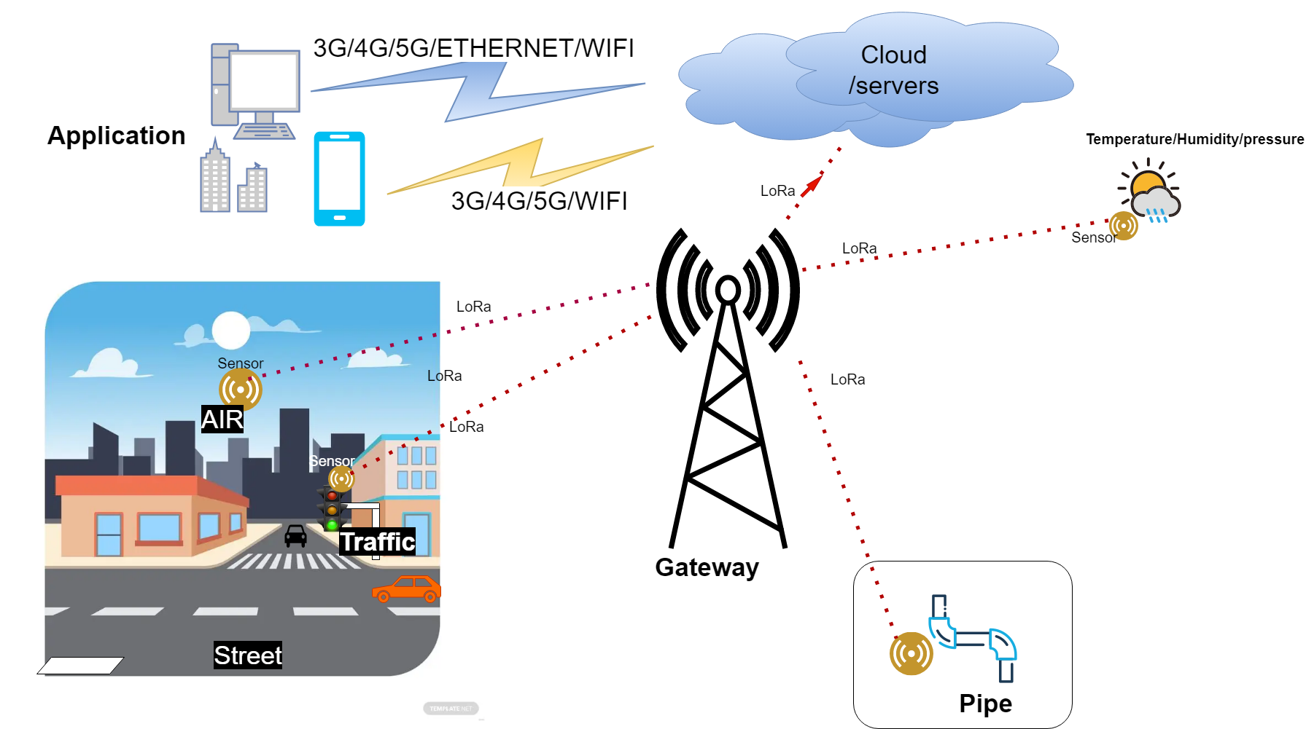
Architectural Diagram (Cont’d)

Slide 16
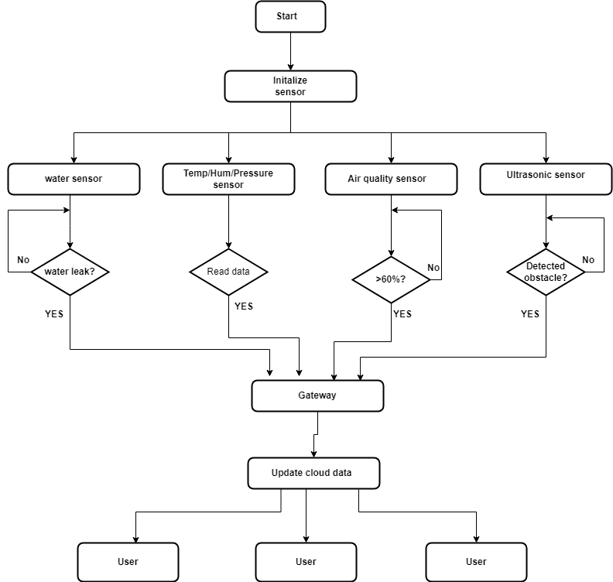
Flow Chart

Slide 17
Resource requirement
LoRa LF band sensor and gateway
Computer
Antennas
Ethernet with internet access
5V battery
USB Type-A and Micro-B cables
STM32CubeIDE
STM32CubeProgrammer
TeraTerm
ST-LINK utility

Slide 18
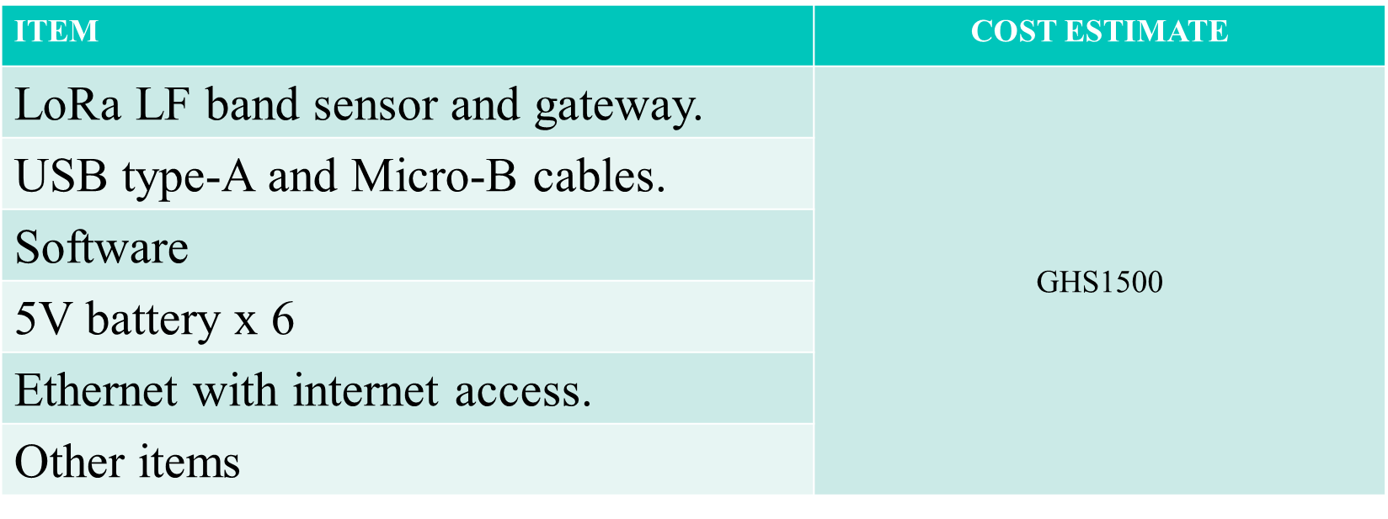
Estimated Budget Cost

Slide 19
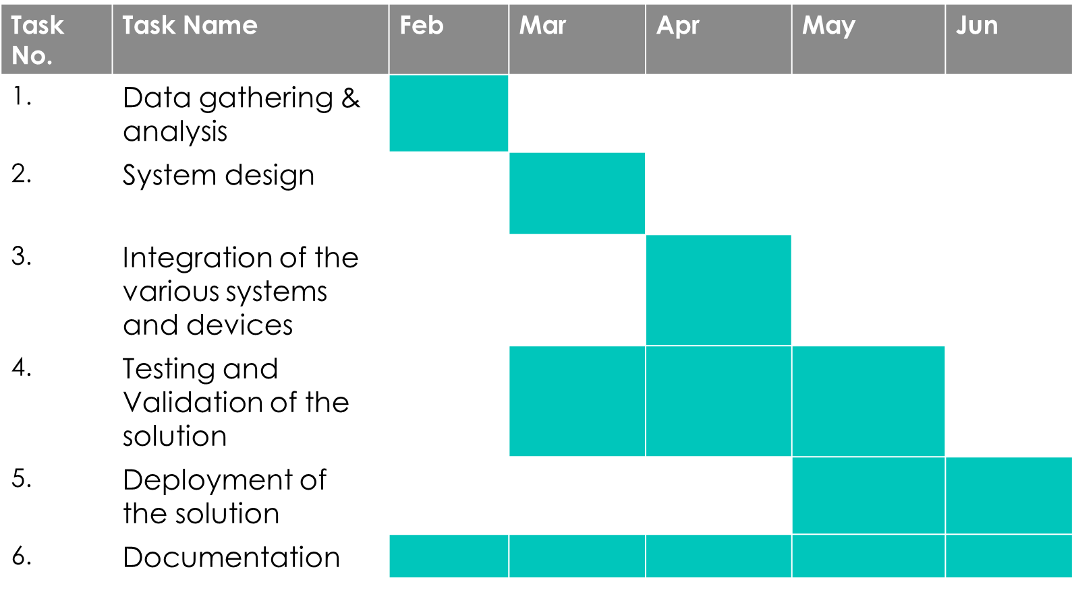
Project Timeline

Slide 20
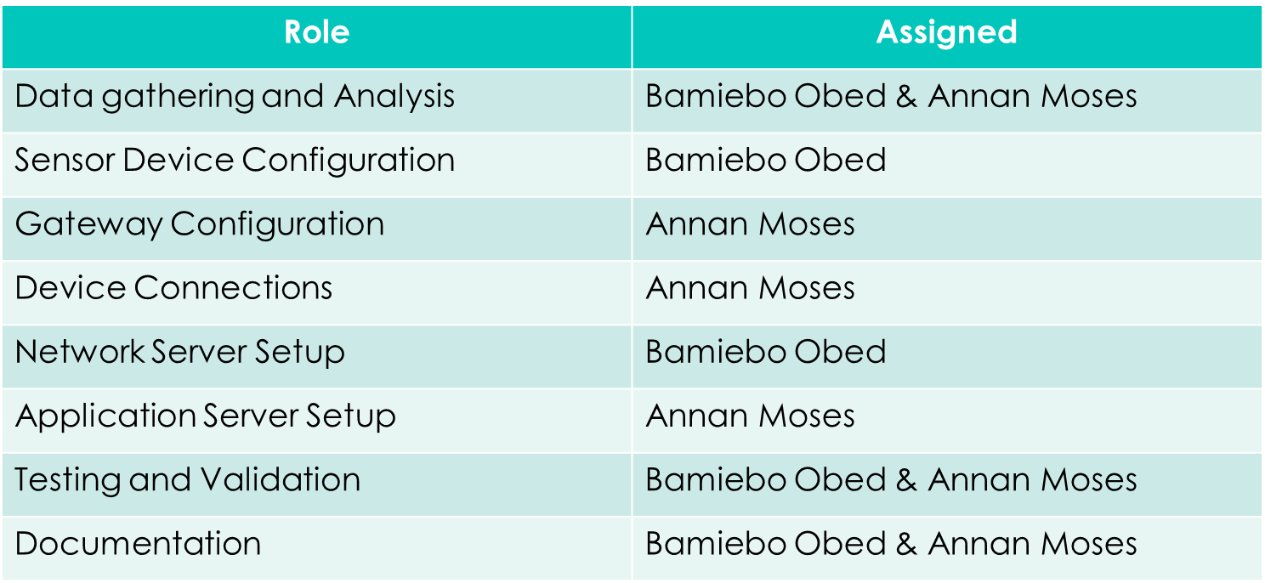
Roles and Responsibilities

Slide 21
Expected Outcome
This project is expected to help address the following challenges faced by cities today:
Monitor air quality in real-time to protect public health.
Monitor and control traffic flow in real-time to reduce congestion.

Slide 22
Expected Outcome (Cont’d)
Monitor and control energy consumption in cities to improve efficiency.
Provide real-time information to citizens to improve their quality of life.

Slide 23
References
[1] Ashish, J.,Menuka, M.,(2022, February). Smart Lighting System Using LoRaWAN Technology. Department of Computer Science and Engineering Nepal Engineering College, Changunarayan, Bhaktapur.
[2] P. Chaudhari, A. K. Tiwari, S. Pattewar and S. N. Shelke, "Smart Infrastructure Monitoring using LoRaWAN Technology," 2021 International Conference on System, Computation, Automation and Networking (ICSCAN), Puducherry, India, 2021, pp. 1-6,

Slide 24
References (Cont’d)
[3] J. Jaime, I. Sousa, M. P. Queluz and A. Rodrigues, "Planning a Smart City Sensor Network Based on LoRaWAN Technology," 2018 21st International Symposium on Wireless Personal Multimedia Communications (WPMC), Chiang Rai, Thailand, 2018, pp. 35-40.
[4] Ramesh, R.,Arunachalam, M.,Atluri, K. H., Kumar, C., Anand S.V.R., Arumugam, P., Amrutur, B., (2020, March). LoRaWAN for smart cities: experimental study in a campus deployment. LPWAN Technologies for IoT and M2M Applications, Academic Press (pp. 327-345).

Slide 25
References (Cont’d)
[5] Anzum, R., (2020, January). LoRaWAN Technology on Air Quality Monitoring for Public Health Protection. World Journal of Environmental Biosciences.

Slide 26
Thank You

